Slide 1

A Scenario Based Evaluation of Global Urban Air Mobility Demand
Authors:
Akshay Anand (Presenter), Harleen Kaur, Dr. Cedric Y. Justin,
Dr. Turab Zaidi, Prof. Dimitri Mavris
Aerospace Systems Design Laboratory at Georgia Tech Lorraine (ASDL@GTL),
International Research Lab Georgia Tech-CNRS, UMI 2958, Georgia Tech Lorraine
AIAA SciTech Forum, 11 – 19 January 2021
Copyright © by Akshay Anand, Harleen Kaur, Cedric Y. Justin, Turab A. Zaidi, Dimitri N. Mavris
Published by the American Institute of Aeronautics and Astronautics, Inc., with permission.
Notes:
Hello everyone, welcome to our presentation, my name is Terry Wen. This study is the second part of two part study titled “a methodology for supersonic commercial market estimation and environmental impact evaluation”
This research project is conducted by ASDL@GTL, located at the international research lab at georgia tech lorraine in France, which is a collaborative effort between georgia tech and French national center for scientific research

Slide 2



Acknowledgments
This project has received funding from the Clean Sky 2 (CS2) Joint Undertaking (JU) under grant agreement No. 864521. The JU receives support from the European Union’s Horizon 2020 research and innovation programme and the Clean Sky 2 JU members other than the Union.
This funding is supporting the “OASyS” project in the CS2 JU
OASyS: Overall Air Transport System Vehicle Scenarios
Notes:
This work is a part of the EU’s Clean Sky 2 joint undertaking, and funding has been made possible through the Horizon 2020 grant.

Slide 3
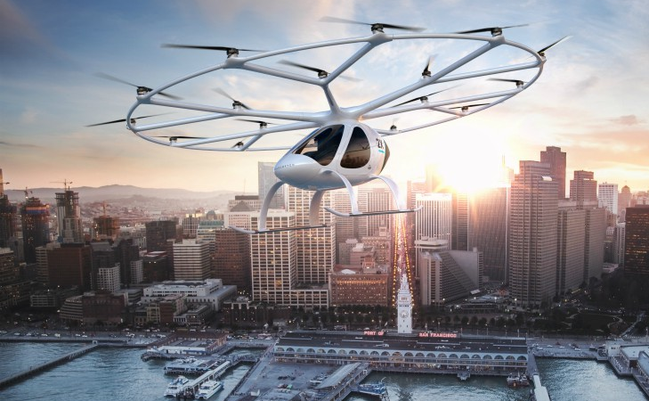
Introduction
Credit: Volocopter
Elements of the UAM flight movement forecasting methodology
Research Questions
1
UAM
Aircraft (Vehicle) Demand
How many UAMs will be flying?
When will they enter the market?
2
UAM Utilization
How often will UAMs be flown?
What would be the total flight hours?
What would be the trip purpose?
Urban Air Mobility (UAM): Air transportation system capable of transporting people directly above populated areas
3
UAM Performance & Infrastructure
What is the speed and range of the UAM?
Where will be vertiports located?
Develop high and low demand scenarios for Urban Air Mobility demand estimation across top 542 global cities
How WTP for UAM will compete other modes of transport?
Will the service be socially accepted?
4
Flight Demand Forecasting
Notes:
I’ll be talking about urban air mobility, which for this presentation is defined as an air transportation system capable of transporting people over above-populated areas. The research objective of this project is to develop a methodology that is capable of generating demand estimates for a set of 542 cities across the globe. The challenge here was to create a methodology that can consider the many different attributes of each city to generate an estimation.
Several research questions associated with UAM aircraft demand, its utilization, performance, infrastructure, and UAM's flight demand forecasting is being investigated in this research. The key objective of this research is to forecast the UAM demand estimates in terms of annual UAM passenger trips, annual UAM PKM, annual UAM utilization, and annual UAM vehicles for low and high demand scenarios from 2035 to 2050 time period.

Slide 4
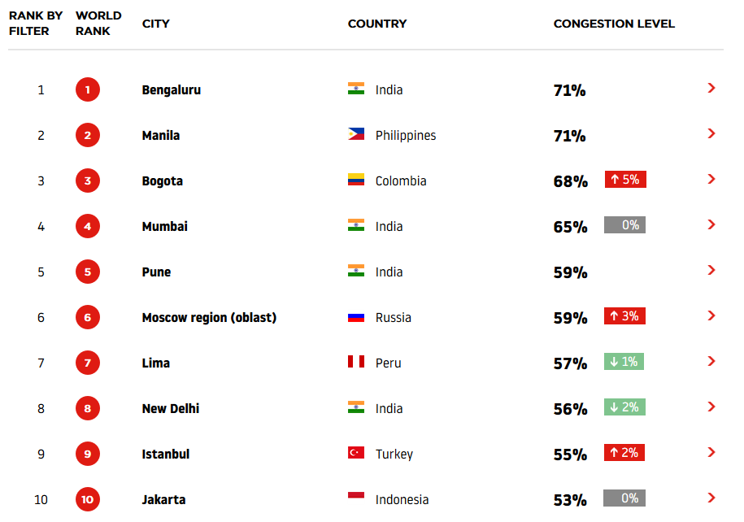
The Business Case of Urban Air Mobility
High and rising levels of roadway congestion is driving the need for a new, faster mode of transport
In 2017, roadway congestion cost US commuters and companies an estimated $166B for extra time and wasted fuel
Source: TAMU Mobility Report
Congestion level indicates additional time spent per trip, respective to uncongested baseline
Notes:
Urban Air Mobility concepts have a business case generated from high levels of roadway congestion in major cities around the world. This figure shows the congestion level or percentage of extra time spent on a trip due to traffic. Travelers in each of the top 10 most congested cities spent more than 50% extra time on roadways. In the US, roadway congestion cost commuters and companies an estimated $166 billion from just wasted time and fuel.

Slide 5

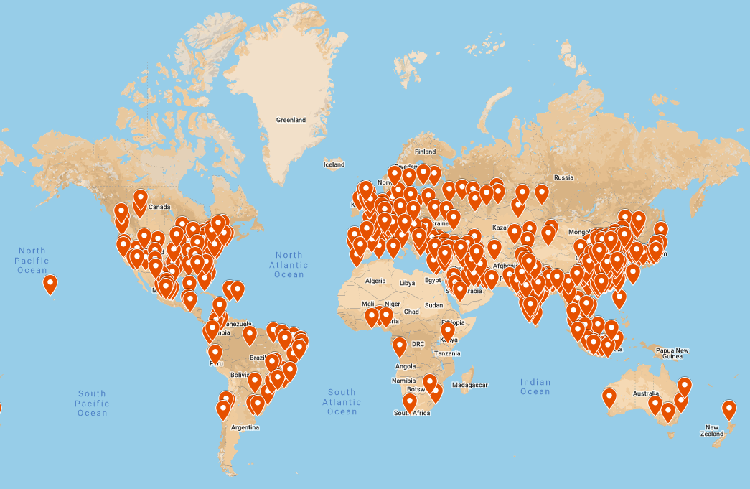
Identification of cities viable for UAM Operations
Factors for Identifying Global Cities
Population Data (2019): Demographia [1]
GDP/Capita Data (till 2050): IHS Markit [2]
Cut-off for Population and GDP
1 Million Population, 5 Billion GDP = 717 cities
Population
Economic Indicators
GDP of a City
1 Million Population, 100 Billion GDP = 535 cities
7 Cities Suggested by Topic Leader (DLR)
542 Global Cities Viable for UAM Operations
Population 2019
Population 2035
Population 2050
Growth Rates provided by DLR
(GDP/Capita) _{country}
(GDP) _{City}
(GDP)_{city} = (GDP/Capita)_{country} * (Population)_{city}
[1]. “DemographiaWorldUrbanAreas,”Tech.rep.,Demographia,2019"
[2]. "https://ihsmarkit.com/index.html"
Notes:
Roadway congestion has many causes but the primary reason is the growth of population at a rapid pace. Therefore the population of a city is selected as one of the filters for a city to be viable for UAM operation, other filters include economic indicators of the city i.e., the GDP per capita of the city for the current and forecast year (2050).
A population filter of 1 Million and a GDP filter of 5 Billion for 2019 and 100 Billion for 2050 is considered as filters to identify the top 535 cities viable for UAM operation in the 2035 to 2050 time frame. Additionally, seven cities are added to account for cities with touristic attractions.

Slide 6

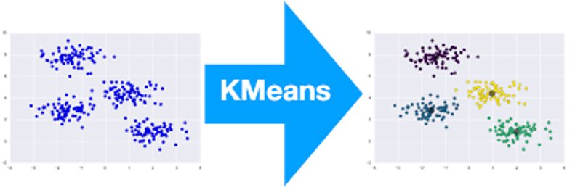
Clustering Approach
After identifying the global cities viable for UAM operation, clustering approach was performed to merge cities with similar characteristics
Land Area
Land Area and Population Density of a city increases proportionally" [1] from current year to year of interest (2050)​
Population Density
Clustering goal is to reduce data dimensionality by finding sets of cities with similar characteristics
Good clustering algorithm must produce high quality cluster in which
The intra-class similarity is high
The inter-class similarity is low
GDP₂₀₅₀ (city level)
(GDP)_{city} = (GDP/Capita)_{country} * (Population)_{city}
GDP₂₀₁₉ (city level)
[1] Julian D. Marshall,“Urban Land Area and Population Growth: A New Scaling Relationship for Metropolitan Expansion", 2007
The authors pursued the K-Means Algorithm for the clustering analysis and identified 22 clusters
Notes:
After identifying the list of 542 cities viable for UAM operation a clustering approach based on 4 clustering parameters was employed to have some dimensionality reduction. Several clustering approaches was studied to select the best clustering approach for our data set. K-means algorithm was then selected to merge cities with similar characteristics. Twenty two was the optimal number of clusters identified for clustering approach. The optimal number of clusters was selected using statistical computer program JMP. A representative city in each cluster is identified. For a single-city cluster city itself acts as representative city while for multi-city clusters the representative city is the city with metrics that are closest to the statistical centroid of the cluster (assuming equal weighting of all attributes). In cases where a representative city is numerically indistinguishable, the subject matter experts’ suggestions from DLR and Georgia Tech were incorporated to select the representative city in each cluster.

Slide 7
UAM Forecasting Assumptions
UAM passenger kilometers traveled (PKM) may be estimated as a portion of the total PKM across all modes of ground transport
Traffic forecasting typically conducted using four-step transportation model​
Infeasible to implement due to data unavailability, effort required, and computational expense
Traffic Analysis Zones (TAZ)
Socio-economic and Land use data
Trip Generation
Trip Distribution
Modal Split
Generic Top-Down Approach
Applied for UAM Demand Estimation
Iterate
Network Assignment
Output
Total Addressable Market
Total Ground PKM
Market Share
UAM Modal Split
Traditional Four-Step Transportation Forecasting Model [1]
Revenue
UAM Demand
[1] Kofi, G. E., “Network based indicators for prioritising the location of a new urban transport connection: Case study Istanbul, Turkey,” 2020
Notes:
As we try to understand how to estimate UAM demand, we should first look at the market in which UAM will play a part in. Based on concepts under development, it is clear that UAM will likely serve intra and inter-city regions while competing with traditional modes of ground transportation such as personal vehicles and public transit.
So, we can estimate UAM traffic to be a portion of the total traffic generated by travelers, which leads to this general top-down approach.
There have been lots of studies in the field of traffic forecasting, specifically aimed at enabling city planning organizations to intelligently plan for new infrastructure developments. One of the most commonly used model traffic forecasting models is the 4-step transportation model. Unfortunately, this process depends on having access to high-quality datasets for each region under study and has high computational expense when considering a global set of cities. In the case of urban air mobility where no historical data exists, many traditional models won’t be sufficient.
Therefore, we need to find an approach which considers the inherent benefits of UAM, without the need for traveler behavior data.

Slide 8
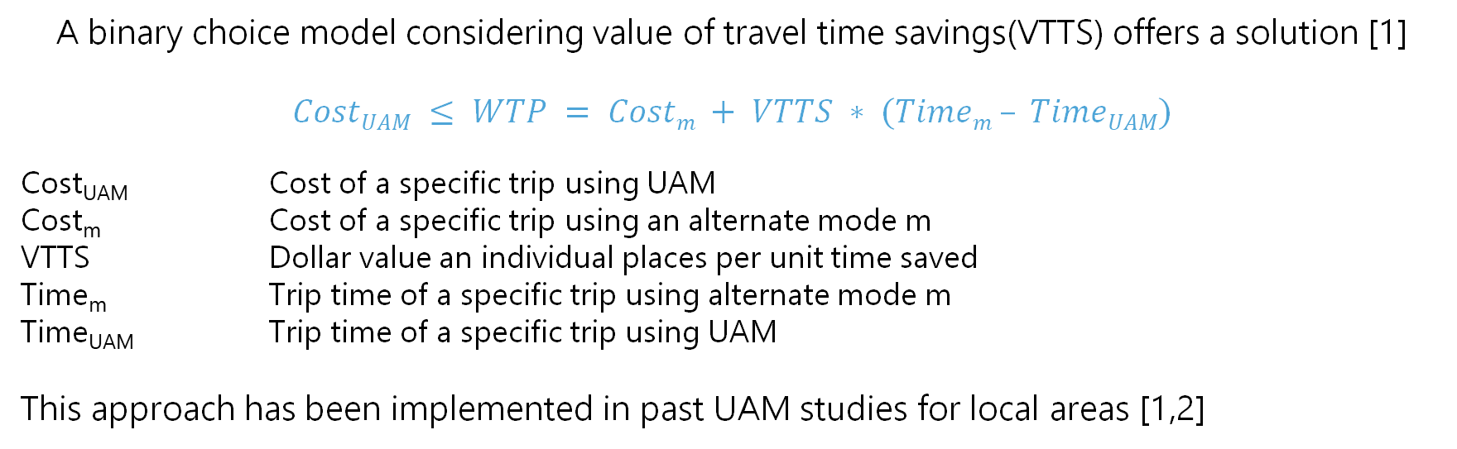
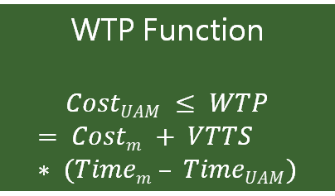
UAM Forecasting Assumptions
A binary choice model considering value of travel time savings(VTTS) offers a solution [1]
$$CostUAM ≤ WTP = Costm + VTTS ∗ (Timem – TimeUAM)$$
Cost_{UAM} Cost of a specific trip using UAM
Cost_{m} Cost of a specific trip using an alternate mode m
VTTS Dollar value an individual places per unit time saved
Time_{m} Trip time of a specific trip using alternate mode m
Time_{UAM} Trip time of a specific trip using UAM
This approach has been implemented in past UAM studies for local areas [1,2]
All alternate travel mode options
WTP Function
$$CostUAM ≤ WTP$$
$$= Costm + VTTS ∗ (Timem – TimeUAM)$$
Viable space for UAM Travel
Calculate
PKM
All possible trip purposes
Total
UAM PKM
Discretized range of trip distance
Discretized range of income level
[1] N. Sirirojvisuth, S. Briceno, and C. Justin, “Life-Cycle Economic Analysis and Optimization for Urban Air Mobility (UAM)” (2020)
[2] Booz Allen Hamilton, “UAM Market Study - Technical Out Breif” (2018)
Notes:
The equation shown here estimates the willingness to pay of travelers for a trip using Urban Air Mobility when compared to some alternate mode of travel. The willingness to pay is estimated as the sum of the cost of a traditional mode of transport, and the value a traveler would place on the time saved through a UAM trip. This approach has been implemented in the past UAM studies for local areas, so there is a promise that it can be expanded to consider a global set of cities with a need for high data requirements. Therefore, we choose to develop a demand estimation methodology with this choice model.
All possible alternate mode of travel options, all possible trip purposes, discretized range of trip distance and income are inputted to the WTP model which evaluate the viable space of UAM travel and then computes the annual UAM PKM.
Now, I will discuss each aspect of this willingness to pay function in detail. For access and egress, we will assume a rideshare option is used to travel the average distance to a vertiport, as defined in the previous slide. Estimating UAM flight cost however requires a detailed cost analysis and could be an entire effort on its own. Instead, we had looked for guidance from existing studies and identify a selection of possible costs to evaluate. A survey of cost models finds costs ranging between about $4/km in the near term, down to less than half a dollar per km in the long term. To capture the extreme limits we computed the UAM demand estimates for high and low demand scenarios for the range of ticket price starting from $0.50 per pax km to $7.50 per pax km

Slide 9
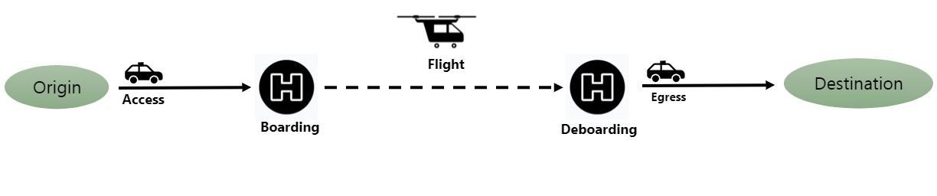
UAM Concept of Operations
Range and Cruise Speed
UAM Ticket Cost
Time for Alternate Mode
Trip Time for UAM
Vertiport Density
Cost for Alternate Mode + Parking Cost
Assumed Demand Parameters
Parameter | Lower Bound | Upper Bound
Average Speed of UAM Vehicle | 120 km/hr | 240 km/hr
Range of UAM Vehicle | 60 km | 120 km
VTTS (Personal, Business) [1] | (35%, 80%) | (60%, 120%)
Vertiport Network Density [2] | 300 sq. km | 120 sq. km
VTTS: Value of Travel Time Savings​
Purpose Split ​
Mode Split ​
Trip Distribution​
Income Distribution​
Total Ground PKM
[1] P. Belenky, “Revised Departmental Guidance on Valuation of Travel,” U.S. Department of Transportation, Washington, DC, 2011​
[2] Mayakonda M. et al. "A Top-Down Methodology for Global Urban Air Mobility Demand Estimation," AIAA Aviation Forum (2020)
Notes:
Urban Air Mobility is a multi-model travel option where a traveler must take some secondary mode of transport to arrive and depart from the origin and destination vertiports. The distance traveled from origin to nearest vertiport is termed as access trip distances this trip distance is covered from a ride-share option. Once at the vertiport, the traveler completes the security check, walks to the UAM vehicle, and boards the UAM vehicle. As the flight reaches the destination vertiport traveler de-boards and uses the second ride-share to reach the destination. The distance between the deboarding vertiport and destination is called egress trip distance. The access and egress trip distances are calculated as a function of vertiport network density. The high demand scenario assumes 1 vertiport at each 120 sq. km land area of the city while the low demand scenario assumes 1 vertiport at every 300 sq. km of the city.
Several other metrics have to be considered to successfully execute the UAM demand estimates for both low and high demand scenario and are listed on the slide. A detailed explanation of each matrix is presented in our manuscript.

Slide 10















Concept of Operations
The elements of the CONOPS can be filled by different data sources or combinations of the data sources
Population, GDP Data
Trip Distribution Data
Income Data
1
2
3
Each module can be supplied or filled with different levels or sources of data
Notes:
The various other metrics of CONOPS can be filled with different levels or a combination of data sets. City-level population data is sourced from Demographia and the GDP/Capita information was sourced from proprietary vendor HIS Markit. For trip distance distribution commercial vendor INRIX provided trip data for all the representative cities. Country-level income was sourced from worlddata, Numbeo source was used to account for the cost of living for each city.

Slide 11
UAM Demand Forecast Algorithm
City Selection
Selection of potential cities worldwide (542)
Identification of representative cities (22)
Scenario Specific Assumptions
Average Speed of UAM (km/hr)
Range for UAM (km)
Vertiport Density (sq. km)
Value per hour time saved (Personal/ Business) (%)
Fixed Model Assumptions
Boarding Time (mins)
De- boarding Time (mins)
Passenger Carrying Capacity
Cost of Ride Share ($/km)
Cost of Operating a Personal Vehicle ($/km)
Ticket Cost Intra- city ($/km)
Ticket Cost Inter- city($/km)
Parking Cost ($) (4 hours)
Purpose Split (Private/ Business) (%)
Modal Split (%)**
Travel Time of Alternate Modes**
Calculation of UAM results for each city based on the following information
Total Ground PKM*
Trip Distance Distribution**
Household Income Distribution*
UAM Ticket price Assumption Ranges
Results
Annual UAM Passenger Trips
Annual UAM PKM
Annual UAM Utilization
Annual UAM Vehicle Trips
If
WTP > UAM Price
UAM Specific Factors
External Factors
*city- level; based on country- level per capita values
**city- level; based on 22 representative cities
Notes:
During the study, researchers developed an in-house model using some advanced libraries of python to forecast the demand for UAM from 2035 to 2050 time frame. The model is based on the willingness to pay (WTP) function. The model has been used in past to forecast the demand estimates for a set of 31 cities. The model considers the assumptions made for both low and high demand scenarios as an input, further several other metrics associated with the concept of operations (CONOPS) are considered by the model. If the WTP of a traveler is greater than the UAM ticket price the there would be a viable UAM trip option and UAM PKM, pax trips, utilization, and vehicle trips are computed. The results are computed at each city based on trip distance distribution, total ground PKM, and household income distributions for a range of ticket prices starting from $0.5 per pax km to $7.5 per pax km.

Slide 12
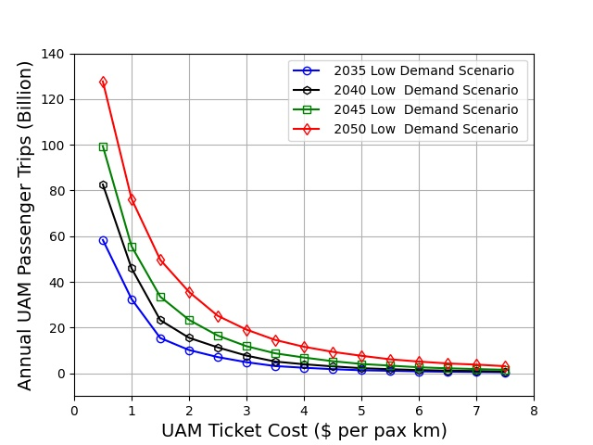
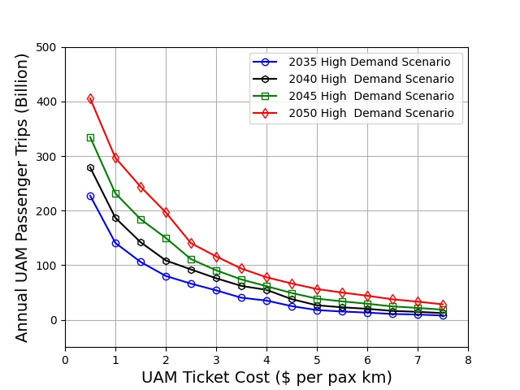
UAM Results and Conclusions
Low Demand
Overall Bounded Scenario Outcomes (Low – High)
 | 2035 | 2050
UAM Pax Trips (Billion) | 0.43 - 227.35 | 3.09- 405.54
UAM Utilization (Billion Hrs) | 0.07 - 11.51 | 0.37 - 20.79
UAM PKM (Billion) | 8.68 - 2762.11 | 43.88- 4990.71
Strong market demand exists for a range of UAM ticket prices and vertiport densities, ranging from 0.43 billion annual pax trips globally up to 400 billion pax trips
Demand expands exponentially with decreases in ticket price and vertiport network density
High Demand
Manufacturers may leverage these results to identify and plan for an optimal production rate
City planners must focus on developing vertiport infrastructure quickly and efficiently
UAM demand estimates are highly sensitive to the assumption made during the research
Notes:
Annual UAM passenger trips increases exponentially with a decrease in the ticket price. The trends in the plot demonstrate that the demand for UAM services grows significantly when the ticket price drops below $3.00 per passenger-kilometer. This value is a global average, and it can be adjusted to create city or region-specific estimates using the cost-of-living index of cities. If manufactures and operators can work together and keep the price below this level then the UAM is more likely to succeed from a global perspective of demand.
In conclusion, we found that a strong market demand exists for a range if UAM ticket prices and vertiport densities, ranging from 0.43 annual pax trips globally up to 400 billion passenger trips
UAM demand estimates expand exponentially with a decrease in ticket price and vertiport network density, the demand estimates are highly sensitive to the assumptions made during the research

Slide 13


Acknowledgments
The authors would like to thank the following entities and people for their contributions:
Clean Sky 2 Joint Undertaking (CS2JU)
Jean-Francois Brouckaert
Jaime Perez-de-Diego
German Aerospace Center (DLR)
Ralf Berghof
Nico Flüthmann
Georgia Tech – Lorraine / Centre National de la Recherche Scientifique
Abdallah Ougazzaden
Jean-Paul Salvestrini
Alexandre Locquet
Nadege Werkle-Dastillung
Aerospace Systems Design Laboratory OASyS Advisory Board
Dimitri Mavris
Elena Garcia
Holger Pfaender
Cedric Justin
Notes:
Thank you for joining the presentation. The other authors and I would like to thank these individuals for their highly valuable contribution to the success of this project.

Slide 14

Thank you!
Questions?
Akshay Anand
Researcher, Georgia Tech Lorraine
Aerospace Systems Design Laboratory | CNRS
aanand@georgiatech-metz.fr
Notes:
If there are any questions, I would be happy to answer them during live sessions.

